Slide 1
Public Assistance Overview
Partner Relations – August 18, 2022

Slide 2
Partner Relations Unit
Redesign
HOPE Florida a Pathway to Prosperity
Partner Relations Unit
Community Partner Inquiries

Slide 3
HOPE Florida
Public Assistance customers
Children aging out of foster care
Pregnant mothers contending with substance use disorders
Parents and families who need assistance
Call 850-300-HOPE to connect to a Navigator
www.MyFloridaMyFamily.com

Slide 4
Family Related Medicaid Program
Children
Parents
Caretakers
Pregnant Women
Individuals under age 26 who aged out of Foster Care

Slide 5
Family Related Medicaid Program
The Department determines eligibility
The assistance group must meet all factors of eligibility
Eligibility ends at the end of the eligibility period
12-month review

Slide 6
Eligibility Criteria
Residency
Identity
Age
U.S. Citizenship or qualified Noncitizen Status
Possession of a valid Social Security Number
Cooperation with Child Support Program
Assignment of Rights for third party payments and income
Parent or other caretaker relative living in the home with a child

Slide 7
Determining Eligibility
The Department determines eligibility
The assistance group must meet all factors of eligibility
12-month review.
Eligibility ends at the end of the eligibility period

Slide 8
Continuous Medicaid
After eligibility has been established, children who become ineligible for Medicaid for any reason remain on Medicaid for up to 12 months from the last application.
Children up to age 5 receive a minimum of 12 months
Children ages 5 up to 19 receive a minimum of 6 months.

Slide 9
Retroactive Medicaid Coverage
Children Under 21
Pregnant Women

Slide 10
Application for Assistance
Individuals may apply for public assistance in person, mail or web-based or facsimile application.
Only the primary applicant or a Designated Representative can sign and submit an application.

Slide 11
Designation
An applicant/recipient, their spouse, legal guardian, Power of Attorney, or a responsible member of the assistance group may appoint an individual or organization to act responsibly on their behalf in assisting with the application/redetermination and other ongoing communication with the Department.
Designated Representatives assume ALL responsibility for the accuracy of the information provided and are subject to the same disqualification penalties and possible prosecution as responsible household members.

Slide 12
Provider Referrals
Hospitals and other Medicaid providers refer individuals who are potentially eligible for Medicaid to the Department for the purpose of making an application.
Individuals have a right to file an application, have an interview if requested and have a determination of eligibility. The applicant has the primary responsibility to obtain and provide information required to determine eligibility for benefits.

Slide 13
SNAP
The purpose of the Food Stamp Program is to help eligible assistance groups obtain a more nutritious diet by increasing food purchasing power through regular market channels.
Assistance groups are authorized benefits electronically through Electronic Benefits Transfer (EBT) which they use to purchase food at retail stores authorized by the USDA. Food stamps are intended to supplement other assistance group income.

Slide 14
Important Reminders
Individuals ages 16-59 may be subject to General Work Rules and/or General Work Rule Exemptions.
The Department of Children and Families remains the designated State agency to determine eligibility for program services/benefits. Community Partners and Partner Staff should refrain from discussing technical factors of eligibility with applicants. DCF and CareerSource are tasked with General Work Rule screening and determinations.

Slide 15
Partner Site’s Role
Safeguard
Safeguard client confidential information
Provide
Provide personnel/staff to assist customers with submitting their applications or other documents to DCF.
Provide
Provide informational handouts
Submit
Submit questions to Partner Relations URL
Ensure
Ensure annual trainings are completed for ACCESS Civil Rights, Voters Registration Training for Community Partners, ACCESS Self Service Portal Training.

Slide 16
Partner Relations Role
Answer policy related inquiries/questions
Assist with password reset
Provide case information
Conduct Trainings
Conduct intake interview if client is present at your location
1
Provide Community Partners with support at community and other outreach events.
Refer customers to HOPE Florida, A Pathway to Prosperity
2

Slide 17
Did you Know….
All individuals have the right to a confidential relationship with the Department and its authorized Community Partners.
All information provided by participants, denied applicants and inactive individuals are to be confidential state Department material; it is not subject to the Freedom of Information Act.

Slide 18
Application
Individuals may apply for public assistance in person, by mail or by web-based or facsimile application. An acceptable application must have applicants name, address and signature on the form. Upon request from the applicant, provide assistance in completing the application.
Individuals must submit an application and initial application, reapplication, recertification and requests for additional assistance.

Slide 19
Expedited Services
During the application process, each applicant will be screened for expedited services.
Examples of Standard Filing Units that may be eligible would have less than $150 monthly in gross income provided liquid assets do not exceed $100. Standard filing units who have loss or decrease in income.

Slide 20
Eligibility Interview
The Department will conduct an eligibility interview by asking a series of questions concerning the household circumstances provided on the application. Discrepancies will also be addressed and resolved during intake interview.
As part of the interview process, the Department will address Food Assistance Work Rules and discuss General Work Rules and General Work Rule Exemptions. This is known as ABAWD –

Slide 21
Authorized Representative
When the payee, or a responsible assistance group member cannot apply for benefits they may be eligible for an Authorized Representative. Additionally, Food Stamp Authorized Representatives may be designated by the primary payee as a secondary cardholder to receive an Electronic Benefits Transfer (EBT) card and be able to access the primary payees Food Stamp Account.
Authorized Representatives must be designated in writing on CF-ES-3010 Authorized Representative form. Designations are valid for the current certification only. Meaning, each certification would require a new designation. Community Partners who are assisting clients with password reset may utilize CF-ES-3010 if signed by the client and submitted to the Department. Record retention period is 3 years for this form and electronic storage is acceptable.

Slide 22
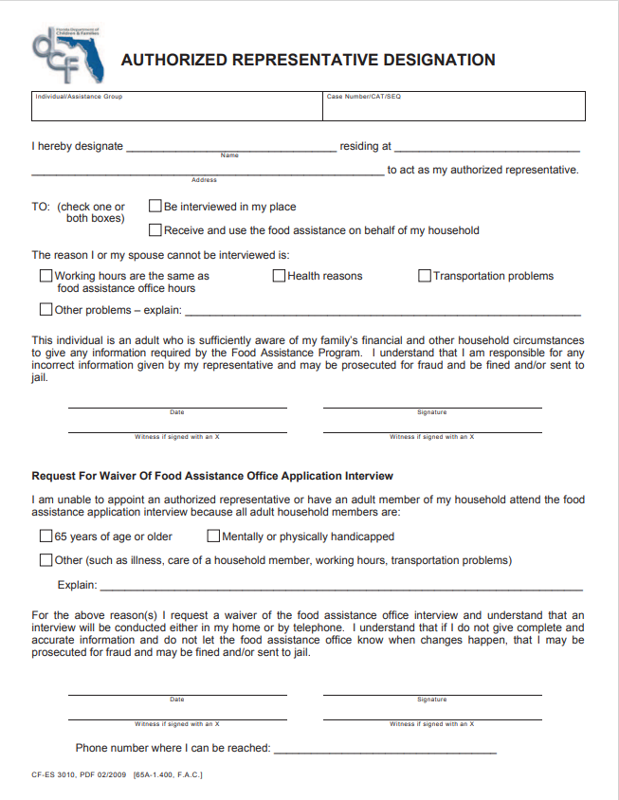
The form must be endorsed by the client

Slide 23
Password Reset and Interviews
Partner Relations can assist authorized Community Partners with a password reset if the client is present on-site at your location. If the client is not present, but has signed the CD-ES-3010, that form can be emailed to Partner Relations, request made to the dedicated URL for password reset without the client being present. Government issued ID must accompany the Authorized Representative form.
There may be instances where a client is not capable of conducting a phone interview for Food Assistance. If a client has an Authorized Representative form on file and the Community Partner has been granted authorization to conduct the interview on the client’s behalf, the partner may do so by emailing Partner Relations the form, government issued ID and submitting the request to the URL. Please note, if personnel/staff are conducting the interview on behalf of the client, the individual completing intake now becomes personally liable for the content relayed to the Department. This is a tremendous responsibility and I encourage partners to err on the side of caution and strongly urge clients to conduct their own interview.

Slide 24
Designated Rep
Applicants/recipients, their spouse, legal guardian, Power of Attorney, or a responsible member of the assistance group may appoint an individual or organization to act responsibly on their behalf in assisting with an application or redetermination of eligibility and other ongoing communication with the Department with respect to Medicaid.
Designated Representatives must be designated in writing on CF-ES-2505 Designated Representative form. Designations are valid for the current certification only. Meaning, each certification would require a new designation. Designated Representatives assume all responsibility for the accuracy of the information provided and are subject to the same disqualification penalties and possible prosecution as responsible household members.

Slide 25
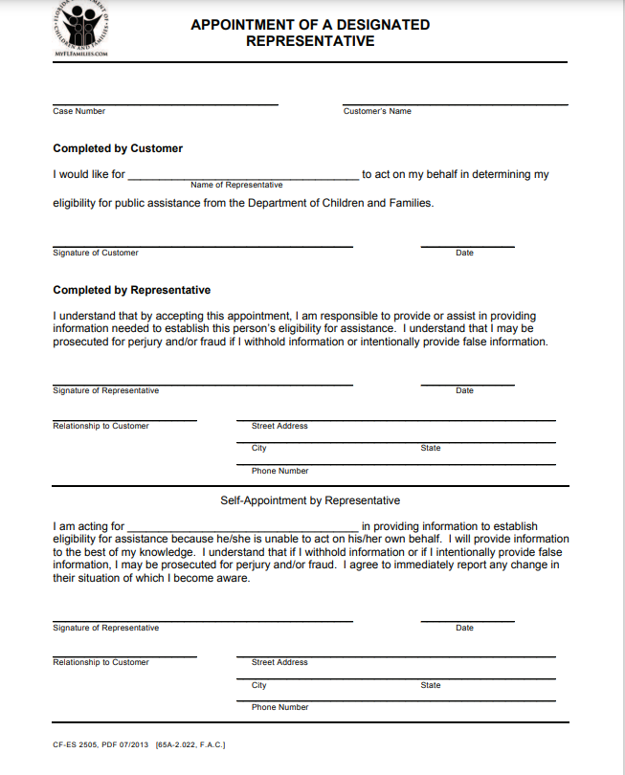
The form must be endorsed by the client

Slide 26
3-year Retention
Authorized Representative is for Food Assistance.
Designated Representative is for Medicaid.

Slide 27
Temporary Cash Assistance
The ACCESS program provides financial and medical assistance, food assistance, and other supportive services to needy persons and families. Each program has eligibility requirements derived from State and Federal law.
The TCA program provides cash assistance to families with children under age 18 (or under age 19 if they are full-time students in a secondary school or its equivalent) that meet the program’s technical, income, and asset requirements. TCA helps families become self-supporting so that children may remain in their own home or the home of a relative.
A child must live in the home of a parent or a relative who is a blood relative of the child. The degree of relationship to the child can be no greater than first cousin once removed. Parents and children, including half-siblings, who live together must apply together.

Slide 28
Program Description
Exempt From Work Requirements
Individual has a child less than three months of age
Individual has SSI or SSDI
Individuals cares for a disabled family member
Individual is exempt from time limits
Not Subject to Time Limits
A family/relative that receives cash for a child only has no time limits (Caretaker Relatives)
Pending SSI/SSDI applicants with RWB approved hardships may receive extensions
Adult household member caring for disabled person in their home

Slide 29
Technical Requirements
To receive TCA for children under age five, the applicant household must verify each child has a complete record of all necessary immunizations or is current with immunizations (ages 1-4)
Individuals must be US Citizens or qualified non-citizens
Individuals must be a resident of Florida
Eligibility for TCA depends on household income. Net countable income (income minus allowable deductions) cannot exceed the maximum possible payment for the family size.
Everyone applying for TCA must have a SSA number
Individuals who are not requesting benefits themselves do not need to provide proof of SSA number
Must cooperate with child support enforcement

Slide 30
Relative Caregiver Program
This special program provides monthly financial support to TCA eligible relatives that:
Have custody of a dependent child adjudicated by a Florida court and placed into their homes by the courts and/or Family Safety.
Families also must be within the fifth degree of relationship to the parent or stepparent of the child placed into their care. This includes any non-related half-siblings.
The eligibility process for this program only examines the needs, income and assets of the child in order to establish eligibility and payment amounts. Based off the age of the child, the monthly maximum payments are as follows:
Age 0 through 5 - $242.00 per child
Age 6 though 12 - $249.00 per child
Age 13 through 17 - $298.00 per child

Slide 31
Relocation Assistance
In some cases, there may be families that require resources to help them escape domestic violence, or perhaps move to another area with greater employment opportunities. These individuals may receive a lump sum relocation payment instead of a monthly TCA benefit.
Families that accept the relocation payment for employment related reasons may not reapply for TCA for six months, unless they have another emergency.
If these families reapply within six months, they must repay a prorated amount of the relocation assistance.
CareerSource determines eligibility for relocation assistance.

Slide 32
Up-Front Diversion
Up-Front Diversion is a one-time payment of up to $1000.00 to help families facing an unexpected emergency. A family receives this payment instead of ongoing TCA.
An Up-Front Diversion payment is available to TCA families that:
Meet certain up-front diversion eligibility requirements
Agree not to apply for TCA for three months, unless they have and emergency, and
Receive approval for the payment from CareerSource.
If the family has an emergency and re-applies within three months of the diversion payment, they must repay the entire diversion payment over an eight-month prorated reduction to the TCA grant.

Slide 33
Cash Severance Benefit
Cash severance is a one-time cash assistance benefit of $1000.00 available to certain recipients who choose to terminate TCA benefits.
Be a recipient of TCA, but also employed and receiving earnings.
Show TCA receipt of at least six consecutive months in the state of Florida since 10/01/1996
Expect to maintain employment for at least six months and sign an agreement not to apply for TCA for six months, except in an emergency
If the family has an emergency and reapplies within the six-month period, it must repay the entire severance benefit through eight months of prorated reduction to the TCA grant

Slide 35
Additional Questions by Community Partners should be submitted to Partner Relations
Submitting Inquiries
To submit an inquiry, the community partner will use the URL located at SunCoast Region Partner Relations (smartsheet.com) and complete the brief form to submit their request directly to the Partner Relations team.
The Partner Relations team will screen, assign, and complete the inquiry within one business day. Complex inquiries may require additional time.
If the inquiry cannot be addressed, a member of the team will contact the community partner to discuss next steps and direct the partner to the appropriate department or unit to assist. The team will respond to the community partner inquiry from the email address SCR.ESS.PartnerRelations@myflfamilies.com
Subsequent or follow-up questions to the initial request should be sent to the Partner Relations email account. A new URL request does not need to be submitted.
All new inquiries should be submitted through the URL.
Organizations who are not existing DCF Community Partners may reach out to Christine.McKee@myflfamilies.com for additional information.

